Slide 1

Sentiment Analysis on Tweets
Notes:
Sentiment analysis (also known as opinion mining) is one of the many applications of Natural Language Processing. It is a set of methods and techniques used for extracting subjective information from text or speech, such as opinions or attitudes

Slide 2
Objective
The objective of this task is to detect hate speech in tweets. For the sake of simplicity, we say a tweet contains hate speech if it has a racist or sexist sentiment associated with it. So, the task is to classify racist or sexist tweets from other tweets.
Formally, given a training sample of tweets and labels, where label '1' denotes the tweet is racist/sexist and label '0' denotes the tweet is not racist/sexist, your objective is to predict the labels on the test dataset. This project is focused on comparing different text representations and learning models on a classification task.

Slide 3
Project Workflow
We will work on a large supervised dataset of English tweet (twitter-hate-speech).We will focus on 4 text representation strategies & 3 classifiers
Bag-of-Words (Bow)
TF-IDF
Word2Vec (w2v)
doc2vec (d2v)
3 classifiers:
Logistic Regression
Support Vector Machine
XGBoost

Slide 4
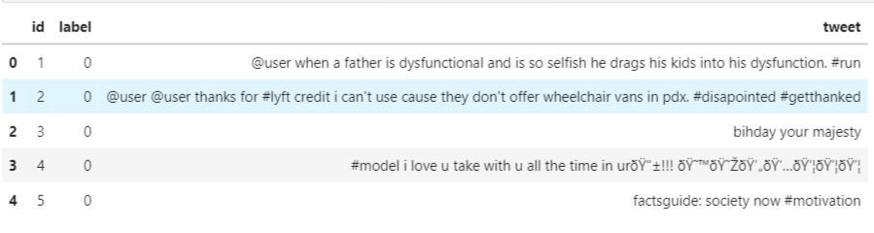
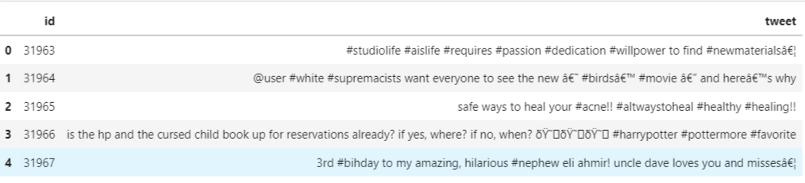
Dataset
(17197, 2))
Train data
(31972,3)
Test data
(17197,2)

Slide 5
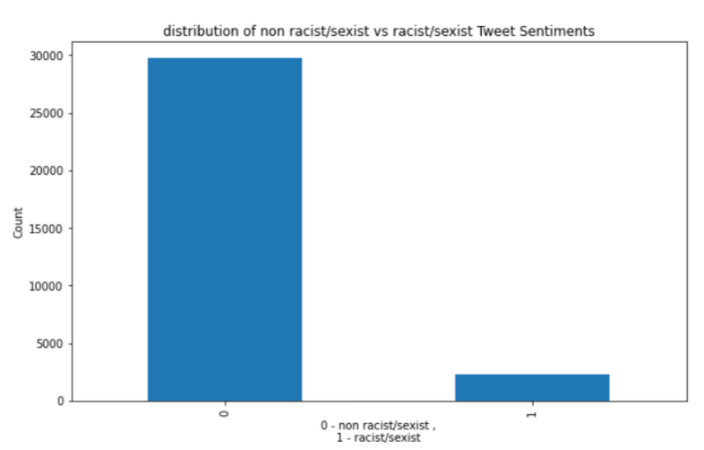
Distribution of training data

Slide 6
Preprocessing
Remove unwanted words
Remove Punctuations
Remove Numbers
Remove Special Characters
Remove short/stop words
Normalizing
Stemming

Slide 7
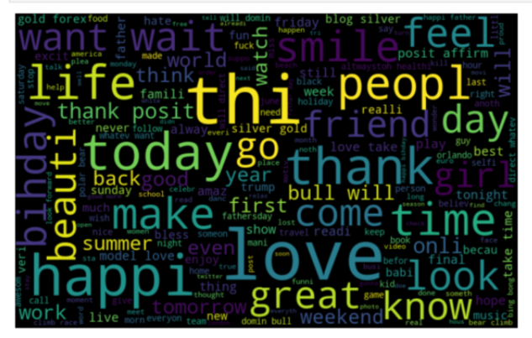
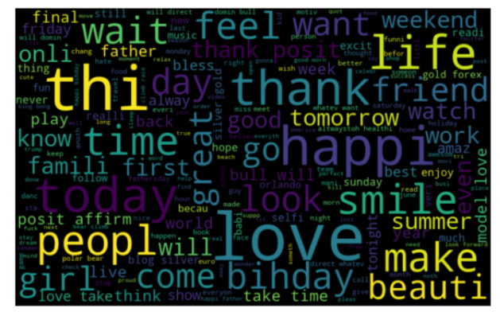
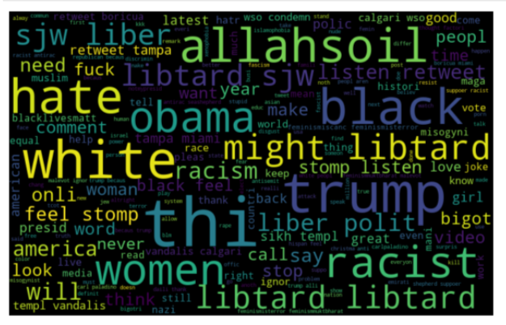
Common words
tweets
O label
1 label
Notes:
What are the most common words in the entire dataset?
What are the most common words in the dataset for non racist/sexist and racist/sexist tweets, respectively?
How many hashtags are there in a tweet?
Which trends are associated with my dataset?
Which trends are associated with either of the sentiments? Are they compatible with the sentiments?

Slide 8
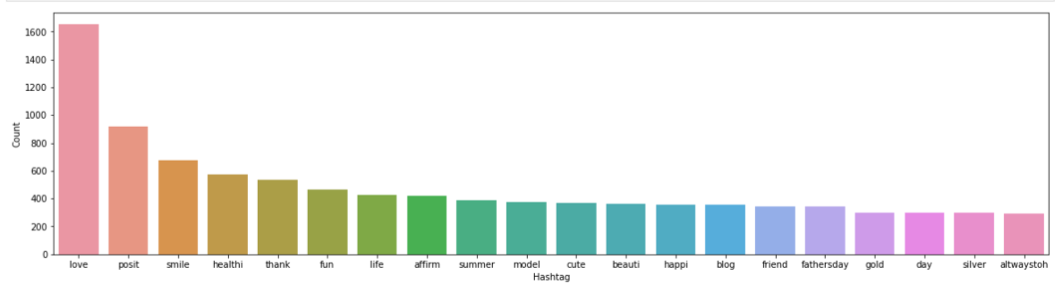
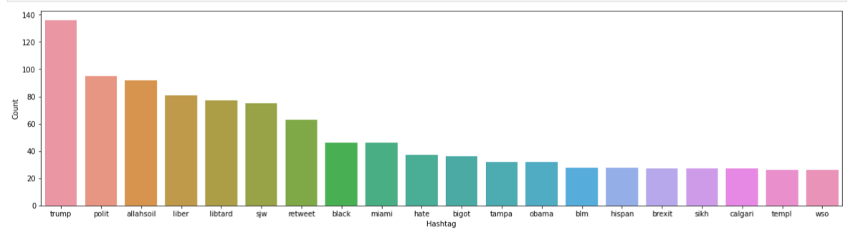
Hashtags in Tweets
0 label
1 label

Slide 9
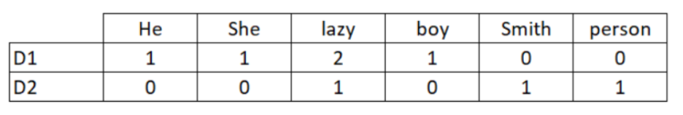
Bag of Words
To analyze a preprocessed data, it needs to be converted into features.
BOW is a representation of text that describes the occurrence of words within a document
Consider a Corpus C of D documents {d1,d2…..dD} and N unique tokens extracted out of the corpus C. The N tokens (words) will form a dictionary and the size of the bag-of-words matrix M will be given by D X N. Each row in the matrix M contains the frequency of tokens in document D(i).
Let us understand this using a simple example.
D1: He is a lazy boy. She is also lazy.
D2: Smith is a lazy person.
The dictionary created would be a list of unique tokens in the corpus =[‘He','She','lazy','boy','Smith','person']
Here, D=2, N=6
The matrix M of size 2 X 6 will be represented as –
CountVectorizer
Notes:
CountVectorizer

Slide 10
TF-IDF
This is another method which is based on the frequency method but it is different to the bag-of-words approach in the sense that it takes into account not just the occurrence of a word in a single document (or tweet) but in the entire corpus.
TF-IDF works by penalising the common words by assigning them lower weights while giving importance to words which are rare in the entire corpus but appear in good numbers in few documents.
Let’s have a look at the important terms related to TF-IDF:
TF = (Number of repetitions of word in a document) / (No of words in a document)
IDF =Log[(Number of documents) / (Number of documents containing the word)]
TF-IDF = TF*IDF
TfidfVectorizer

Slide 11
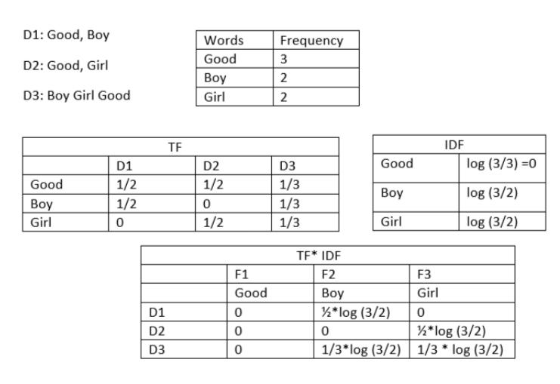
TF-IDF -2

Slide 12
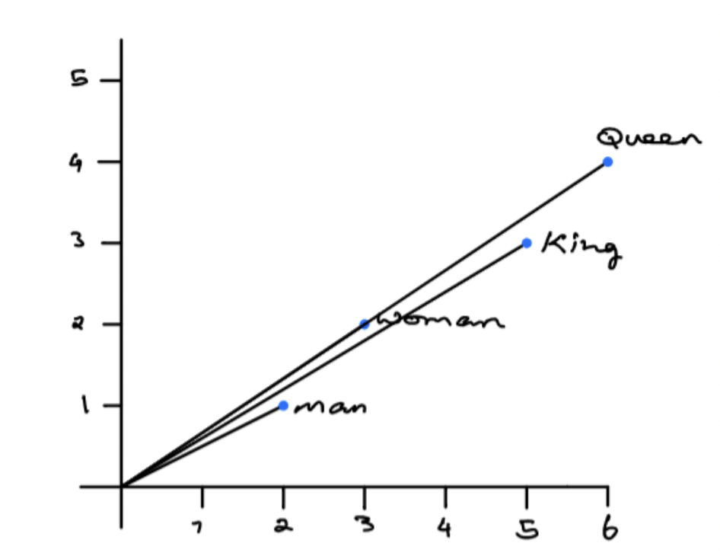

Word2vec
Word embeddings - Mapping of the words in a vector space
Word embeddings are the modern way of representing words as vectors. The objective of word embeddings is to redefine the high dimensional word features into low dimensional feature vectors by preserving the contextual similarity in the corpus.
They are able to achieve tasks like King -man +woman = Queen, which is mind-blowing.
The Word2Vec model is used to extract the notion of relatedness across words or products such as semantic relatedness, synonym detection, concept categorization, selection preferences, and analogy.
A Word2Vec model learns meaningful relations and encodes the relatedness into vector similarity.

Slide 13
Word2vec -2
Word2Vec model takes a text corpus as input and produces the word embedding vectors as output.Word2Vec is not a single algorithm but a combination of two techniques
CBOW (Continuous bag of words) – predict a word on the basis of its neighbors
Skip-gram model – predict the neighbors of a word
Pre-trained model – genism

Slide 14
Word2vec - 3
The advantages of using word embeddings over BOW or TF-IDF are:
Dimensionality reduction - significant reduction in the no. of features required to build a model.
It capture meanings of the words, semantic relationships and the different types of contexts they are used in.
Deals with addition of new words in the vocabulary
Better results in ML & DL applications

Slide 15
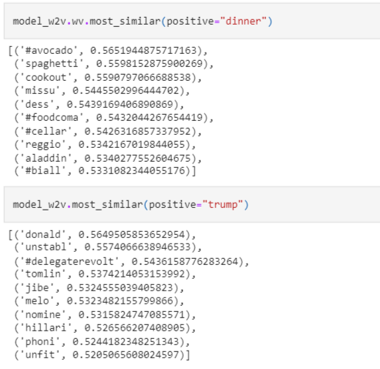
Word2vec - 4
Word2vec does a good job in finding the most similar words in a given word because it has learned vectors for every unique word in our data and it uses cosine similarity to find out the most similar vectors (words).

Slide 16
Doc2vec
Doc2Vec model is an unsupervised algorithm to generate vectors for sentence/paragraphs/documents.
This approach is an extension of the word2vec.
The major difference between the two is that doc2vec provides an additional context which is unique for every document in the corpus. This additional context is nothing but another feature vector for the whole document. This document vector is trained along with the word vectors.
To implement doc2vec, labelise or tag each tokenised tweet with unique IDs. This was done by using Gensim’s LabeledSentence() function.

Slide 17
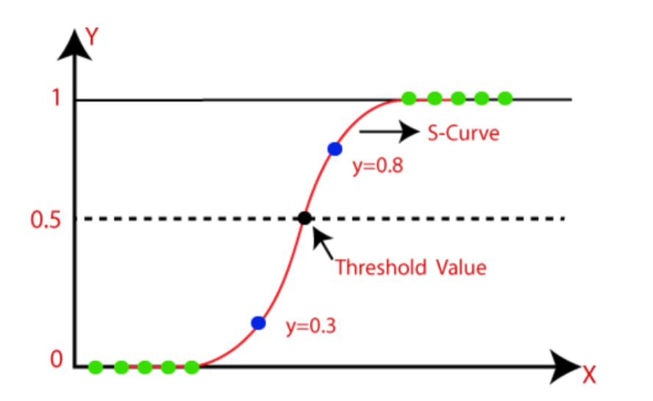
Logistic Regression
Logistic Regression is a classification algorithm. It is used to predict a binary outcome (1 / 0, Yes / No, True / False) given a set of independent variables.
Probability never goes below 0 and above 1.

Slide 18
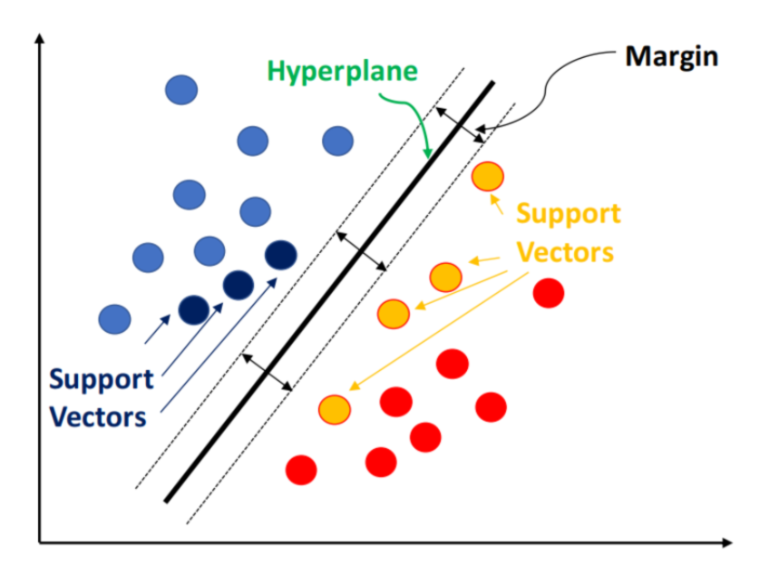
Support Vector Machine
Support Vector Machine (SVM) is a supervised machine learning algorithm which can be used for both classification or regression challenges. However, it is mostly used in classification problems.
In this algorithm, we plot each data item as a point in n-dimensional space (where n is the number of features you have) with the value of each feature being the value of a particular coordinate.
Then, we perform classification by finding the hyper-plane that differentiate the two classes as shown in the plot below:

Slide 19
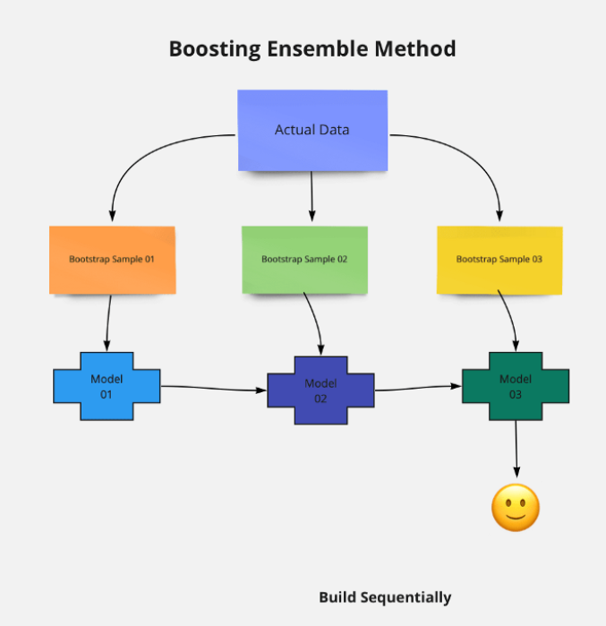
XGBoost
Extreme Gradient Boosting (xgboost) is an advanced implementation of gradient boosting algorithm. It has both linear model solver and tree learning algorithms. Its ability to do parallel computation on a single machine makes it extremely fast. It also has additional features for doing cross validation and finding important variables. There are many parameters which need to be controlled to optimize the model.
Some key benefits of XGBoost are:
Regularization - helps in reducing overfitting
Parallel Processing - XGBoost implements parallel processing and is blazingly faster as compared to GBM.
Handling Missing Values - It has an in-built routine to handle missing values.

Slide 20
Evaluation Metrics
F1 score is being used as the evaluation metric. It is the weighted average of Precision and Recall. Therefore, this score takes both false positives and false negatives into account. It is suitable for uneven class distribution problems.
The important components of F1 score are:
True Positives (TP) - These are the correctly predicted positive values which means that the value of actual class is yes and the value of predicted class is also yes.
True Negatives (TN) - These are the correctly predicted negative values which means that the value of actual class is no and value of predicted class is also no.
False Positives (FP) – When actual class is no and predicted class is yes.
False Negatives (FN) – When actual class is yes but predicted class in no.
Precision = TP/TP+FP
Recall = TP/TP+FN
F1 Score = 2(Recall * Precision) / (Recall + Precision)

Slide 21
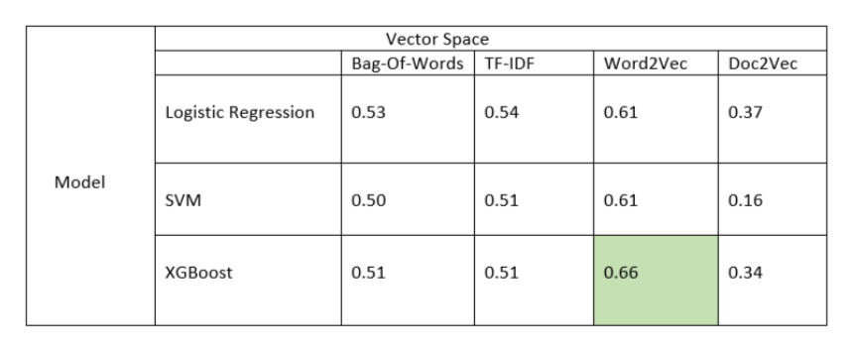
Validation F1 score

Slide 22
Hyperparameter Tuning XGBoost + Word2vec
learning rate of 0.3
Tune tree-specific parameters such as max_depth, min_child_weight, subsample, colsample_bytree keeping the learning rate fixed.
Tune the learning rate.
Finally tune gamma to avoid overfitting.

Slide 23
Results
After hyperparameter tuning the model’s performance was improved and the accuracy reached to 68%.

Slide 24
Thank You

